Slide 1
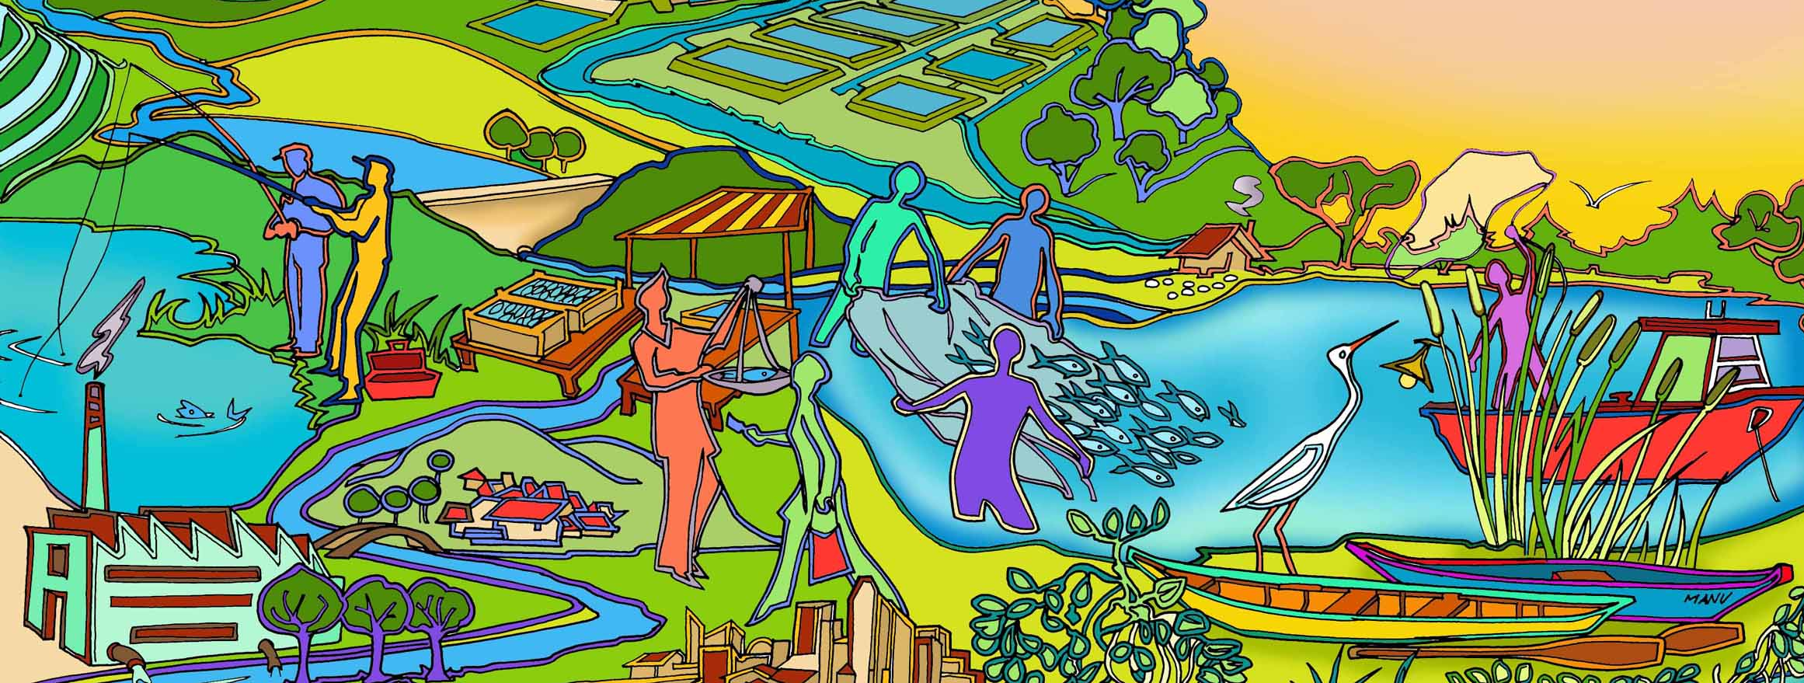
Session 2
Inland fisheries management and the ecosystem approach
Essential EAFm training
Date |Place

Slide 2
Session objectives
After this session you will be able to:
Realize that a broader management approach is required to address the many threats and issues facing inland fisheries
Recognize how ecosystems benefit human societies
Describe the concept of the ecosystem approach (EA)
Explain some of the benefits of using an EA
Notes:
Self explanatory
We have brainstormed issues and threats in the the previous session….
Note:
Management needs to be broad and include all the important (priority issues) threats and issues.

Slide 3
What is Fisheries Management?
Fisheries management: “An integrated process that aims to control fishing activities to improve the benefits that society receives from harvesting fish”. Adapted from FAO
The many threats and issues identified in Session 1 require management to:
minimize their impact and
improve the benefits to society
Notes:
Let us start by understanding what fisheries management is trying to achieve.
The many threats and issues identified in Session 1 require management to
minimize their impact and
improve the benefits to society. One definition is “An integrated process that aims to improve the benefits that society receives from harvesting fish”.
Background info
This definition of management is adapted from FAO. It stresses the integrated nature of a number of activities, including (i) data and information gathering, (ii) analysis, (iii) planning, (iv) decision making, (v) allocation of resources and (vi) enforcement and compliance.

Slide 4
Components of fisheries management
Laws and regulations
Compliance & enforcement
Data & information
Policy & planning
Stakeholder engagement
Fisheries
Management Plan
Notes:
Let us look at the components of fisheries management.
Fisheries management is an integrated process that includes :
formulation and implementation of rules and regulations
compliance and enforcement of the rules,
collecting and analysing data and information (including traditional knowledge) to inform decision making,
stakeholder engagement, and
policy & planning.
Central to all these activities is the Fisheries Management Plan.
See same figure 2.1 in Module 2 Participant Handbook

Slide 5
Fisheries Agency structure
Ministry of Agriculture, Forestry & Fisheries
Department of Fisheries
Policy Section
Foreign Affairs
Section
Admin Section
MCS Section
Fisheries Management Section
Aquaculture Section
Post-harvest:
Food quality
Section
Research Institutes
Co-management Support Unit
Extension Section
Notes:
Let us look at a typical structure of a national fisheries agency.
There are often different Divisions/Sections in a Fisheries agency that carry out these different activities.
Same visual is Figure 16.3 in Module 16.

Slide 6
What are the roles of a fisheries manager?
Person (or persons) who coordinates all the activities of fisheries management for a given fishery:
informed decision making
formulation and implementation of rules and regulations
compliance and enforcement
allocation of resources
negotiation
Notes:
A Fisheries Manager is person who is responsible for coordinating all the management activities for a given fishery.
This includes:
informed decision making
formulation and implementation of rules and regulations
compliance and enforcement
allocation of resources
negotiation

Slide 7
Typical, existing fisheries management
Possible characteristics:
Mainly focused on target species & stock assessment
Single sector specific (fisheries)
Mainly control of fishing (e.g. gear restrictions, seasonal closures, conservation zones)
Based on biological objective e.g. maximizing production
Notes:
The typical (or existing) fisheries management in the country/region will differ among countries and locations;
It may include co-management.
This slide introduces a few possible characteristics that may reflect participants experience.
In the next activity (next slide), participants will be asked to characterize fisheries management that they know.

Slide 8
Group activity
Discuss what you know about existing fisheries management in your country
Sort the threats and issues identified earlier into:
  Those that can be addressed by existing fisheries management (e.g. with a tick); and
  others.
Notes:
[10 minutes]
Instruction: The group to discuss what they understand about fisheries management that exists in their countries.
Have participants categorize their previously identified threats and issues into 2 categories – those that can be addressed by existing fisheries management and those that can not (e.g. tick the ones that can).
Stick them up on flip charts
Go around the room and highlight the the issues identified
The purpose is to illustrate that many of the threats and issues are not fisheries-specific but broader to the wider ecosystem (which is why we need EA- see next slide).

Slide 9
Conclusions: existing fisheries management has some gaps
Fishery resources are seriously degraded in the region with many issues
Existing fisheries management does not cover all threats and issues and can often fail
A broader and more inclusive approach is needed that builds on existing management
Notes:
Based on their activity, discuss that existing fisheries management, due to its fisheries specific focus, is not capable of addressing many of the threats and issues facing the fisheries.
The purpose is to illustrate that many of the threats and issues are not fisheries specific but broader to the wider ecosystem and that we need a broader approach.

Slide 10















Inland fisheries lie within aquatic ecosystems… the bigger picture
Climate change rainfall
Mining runoff
Deforestation
Soil erosion
Reservoir & lake fisheries
Urban water demand & sewage
Irrigation & hydropower dams
Urban markets
Industrial wastewater
Agriculture, water, land use & runoff
Irrigation structures
Fish traders
Aquaculture
Fish refuges & protected areas
River & floodplain fisheries
Wetlands
Saltwater barrage
Many natural and man-made issues impact inland fisheries
Can you think of any others?
Notes:
Fisheries management needs to consider more than people in boats, fish in the water.
It needs to move from considering just fisheries to considering the main components in the ecosystem and their interactions.
See same figure 2.2 in Module 2 Participant Handbook
You may use the 5-min videoclip which expands on these ecosystem interactions. The videoclip can be accessed as an mp4 file in Trainer Resource folder or as a YouTube video here https://youtu.be/IQsr-L8tk9Q

Slide 11
What is an ecosystem?
“An ecosystem can be defined as a relatively self-contained system that contains plants, animals (including humans), micro-organisms and non-living components of the environment as well as the interactions between them.” SPC (2010)
Notes:
Read out/ participants read definition module 2 (p.37?).
Ensure all are ok with this definition. Fish species depend upon their surrounding and supporting ecosystems, which are affected by fishing activities, other human activities, as well as natural processes.
Back ground information
Fish species depend upon their surrounding and supporting ecosystems, which are affected by fishing activities, other human activities, as well as natural processes. Fishing can impact aquatic ecosystems by: (1) catching unwanted species (bycatch); (2) causing physical damage to (benthic/riparian) habitats; and (3) disrupting food chains. Other human activities unrelated to fishing, such as agriculture, forestry, shoreline development, industry, agriculture, irrigation, and introduced species and pathogens can also affect inland water ecosystems, including the many species that comprise them. Human and natural impacts on ecosystems are increasingly being exacerbated by the effects of human-induced climate change.

Slide 12


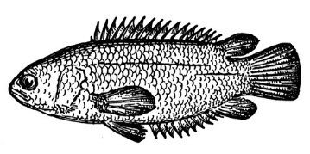
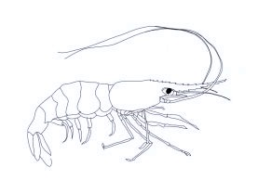
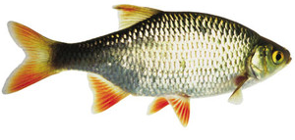
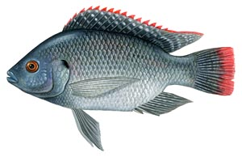
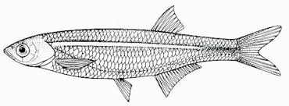
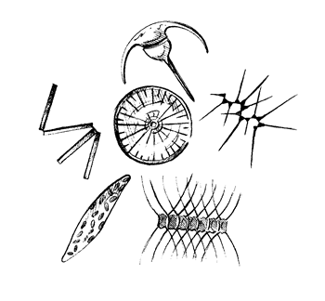
Top predators
Decomposers
Bacteria
Fungi
1st Level carnivores
Omnivorous
consumers
Herbivorous
consumers
Primary Producers
(phytoplankton, plants)
Sunlight energy
Notes:
Note that this is not the picture of an ecosystem we use in EA.
This is a typical picture that a biologist or ecologist would use when talking about fishery interactions.
But it does not meet our definition that is focused more on humans and their use of ecosystems.

Slide 13
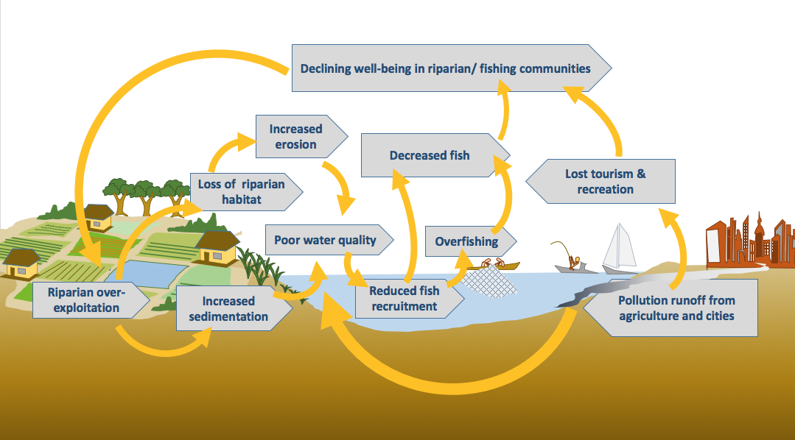
Ecosystem Linkages
Notes:
An ecosystem approach looks wider…..An important thing to understand is that many elements are interconnected.
Something affecting one part of the system can also have flow-on effects on other parts.
For example, Starting with increased exploitation of riparian environment, this leads to decreased fisheries in the middle of the diagram.
This results in declining human well-being (top of diagram) that causes increased habitat destruction (left of diagram) and increased sediment and loss of riparian habitat.
The result is decreased fish resource.

Slide 14
Ecosystem services & benefits
Supporting – e.g. food webs of plants and animals
Provisioning –e.g. supply of fish for animal and human food
Regulating – e.g. coastal protection and resilience against variability and change, as well as natural disasters
Cultural – e.g. recreation, cultural and traditional heritage values
Notes:
Humankind benefits from a multitude of resources and processes that are supplied by ecosystems.
Collectively, these benefits are known as ecosystem services.
These are very broad and can be grouped into:
Supporting services: ecosystem services "that are necessary for the production of all other ecosystem services". e.g. food webs
Provisioning services: "products obtained from ecosystems" e.g. fish for food
Regulating services: "benefits obtained from the regulation of ecosystem processes" e.g. coastal protection
Cultural services: "nonmaterial benefits people obtain from ecosystems e.g. recreation, spiritual enrichment, traditional and heritage values.

Slide 15
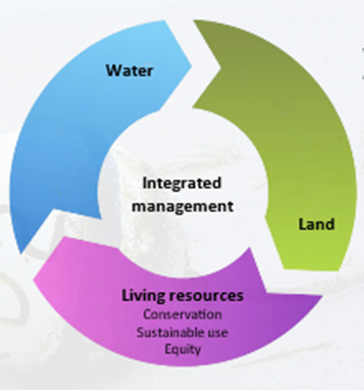
Ecosystem approach (EA)
A strategy for the integrated management of land, water and living resources that promotes conservation and sustainable use in an equitable way (CBD 2000)
The balance of conservation with sustainable use in an equitable way underpins the concept of sustainable development
Note: EA is often called ecosystem-based management (EBM)
Notes:
We have considered what an ecosystem is.
We now introduce the ecosystem approach.
Definition comes from the Convention on biodiversity (CBD).
Important to stress that EA is an INTEGRATED MANAGEMENT APPROACH.
Also used interchangeably with EBM = Ecosystem-based management
The ecosystems approach is the way to implement sustainable development.

Slide 16
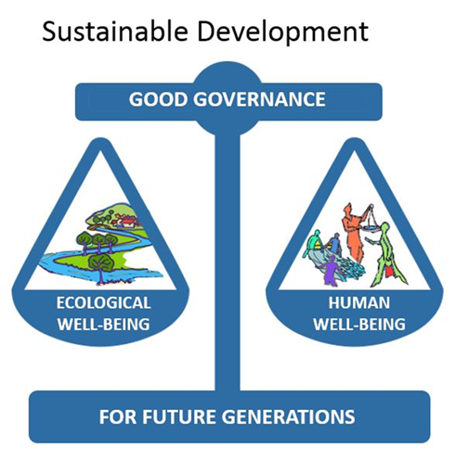
Notes:
Can anyone describe sustainable development?
Sustainable development can be thought of finding a BALANCE between human well-being and ecological well-being through good governance for future generations.
We will look into what “ecological well-being” and “human well-being” and” good governance” are in the next few slides.
See same figure 2.3 in Module 2 Participant Handbook

Slide 17
The 3 components of sustainable development
Ecological well-being: e.g. healthy habitats, foodwebs, and sustainable fishing
Human well-being: e.g. increased & equitable wealth, food security and sustainable livelihoods
Good governance: e.g. effective institutions and arrangements for setting and implementing rules and regulations
Notes:
Recap on the 3 components with examples for fisheries.
Examples of ecological well-being include: healthy habitat protection and restoration, sustainable fishery resource and harvesting, pollution reduction of wastes.
Examples of human well-being include: increased & equitably distributed wealth, sustainable livelihoods.

Slide 18
Sustainable development
“Development which meets the needs of the present without compromising the ability of future generations to meet their own needs.”
The ecosystem approach is a practical way to implement sustainable development.
Notes:
See Module 2 for same definition of sustainable development.

Slide 19
Activity
Plenary brainstorm:
What are the benefits of taking an ecosystem approach?
Tip: keep in mind that we are trying to promote sustainable development
Notes:
Trainer: ask participants to identify benefits of taking an ecosystem approach and discuss them.

Slide 20
What are the benefits of an Ecosystem Approach?
Integrated approach that allows trade-offs when balancing human and ecological well-being
Allows adaptive management – leading to more effective planning
Increase in stakeholder participation
Notes:
Benefits are of EA are further considered when considering EAFm, but good to introduce them here (slides 20+21). The main benefits are:
1. EA facilitates trade offs. This helps resolve inter-sectoral conflicts; enables consideration of diverse stakeholders’ priorities and allows better balancing of resource use objectives with conservation objectives.
2. EA also allows adaptive management = by learning from the outcomes of previously employed management.
3. Reiterate that EA allows for more inclusive and equitable fisheries and integrated freshwater/landscape resource planning and decision making. Increased stakeholder participation can result in:
more transparent planning
increased equity in the use of shoreline and inland resources
recognizes cultural and traditional values
protects the fishing sector from the impacts of other sectors and vice versa
promotes gender equality

Slide 21
What are the benefits of an Ecosystem Approach? (cont.)
Provides a way to consider large-scale, long-term issues (e.g. climate change)
Increased political support
Access to finances resources
Notes:
Benefits of EA (continued).
4. EA provides a framework for considering longer-term issues and outcomes.
5. EA leads to increased political support
fosters political and stakeholder support
Access to finances resources
6. EA access to finances resources. When there is a plan in place and decisive action, funders (national/provincial/district governments, NGOs and international donors) are more likely to support the actions.

Slide 22
Key messages:
Threats and issues to sustainable fisheries are broad in scope
  a number fall outside existing fisheries management
  a broader approach is needed
EA is about integrative management across land, water and living resources
EA is a way of implementing sustainable development that promotes:
  balancing ecological well-being with human well-being through good governance
Notes:
Run through the key messages

